Slide 1
Outlier
Student Height (ft)
0 1 2 3 4 5 6 7 8

Slide 2
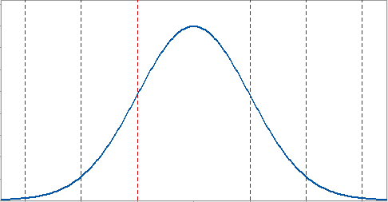
-1 SD
1 SD
A
Values
Z-Score: -1.5
Mean

Slide 3
Q1
Q3
IQR
Median
1.5 * IQR
whisker
whisker
Outlier
Student Height (ft)
0 1 2 3 4 5 6 7 8

Slide 4
Split 1
Outlier
Student Height (ft)
0 1 2 3 4 5 6 7 8

Slide 5
Split 1
Split 2
Outlier
Student Height (ft)
0 1 2 3 4 5 6 7 8

